Slide 1
Identification of new susceptibility loci
for psoriasis using Human Exome BeadChip
Sören Mucha, PhD
Mai 7th 2014

Slide 2
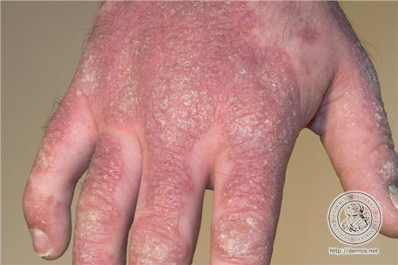
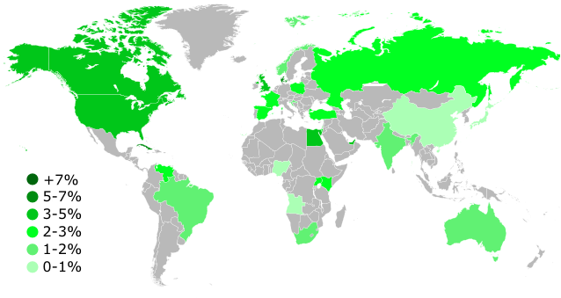
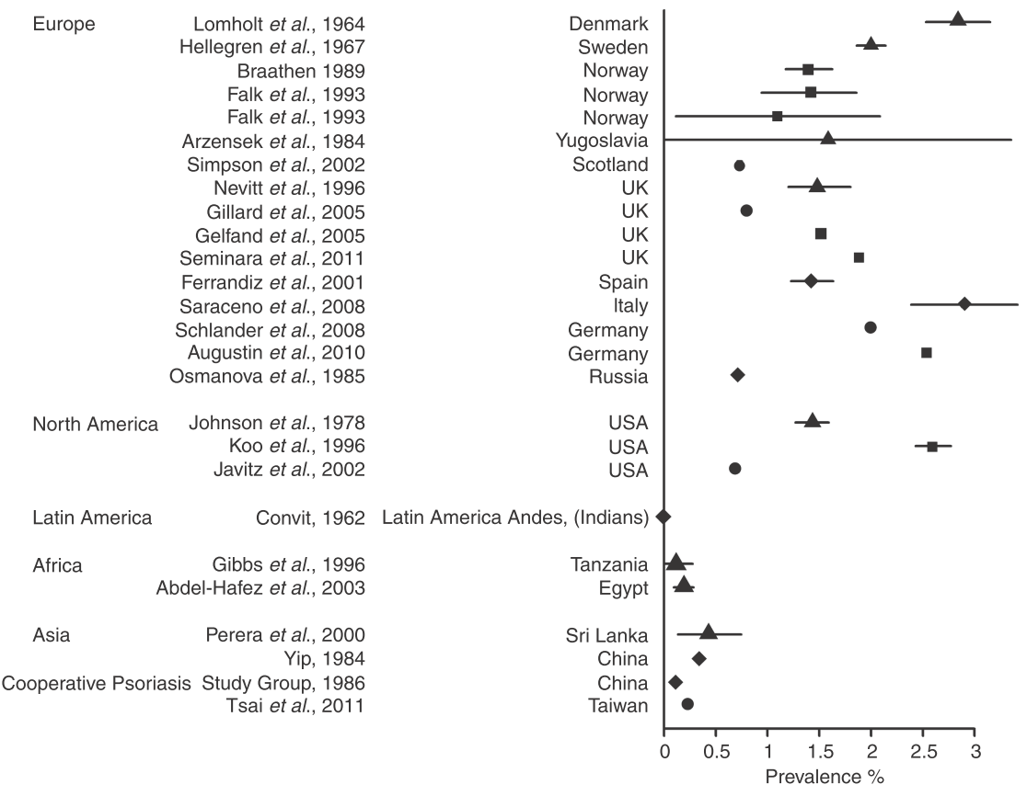
Psoriasis
Chronic, immune-mediated inflammatory skin disease
Equal rates for men and women
Genetic and environental components
85 % of type I psoriasis are HLA-Cw6 carriers
Similar structure of bacterial proteins and human keratin
Psoriasis - affected hand [1]
Worldwide distribution of psoriasis (1971) [2]
Prevalence of psoriasis [3]
Notes:
2

Slide 3
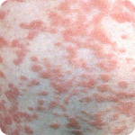
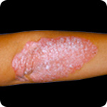
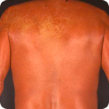
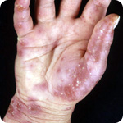
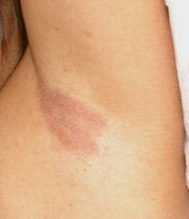
Types of psoriasis
Guttate psoriasis [4]
Plaque psoriasis
(psoriasis vulgaris) [4]
Erythrodermic psoriasis [4]
Pustular psoriasis [4]
Inverse psoriasis [5]
Notes:
3

Slide 4
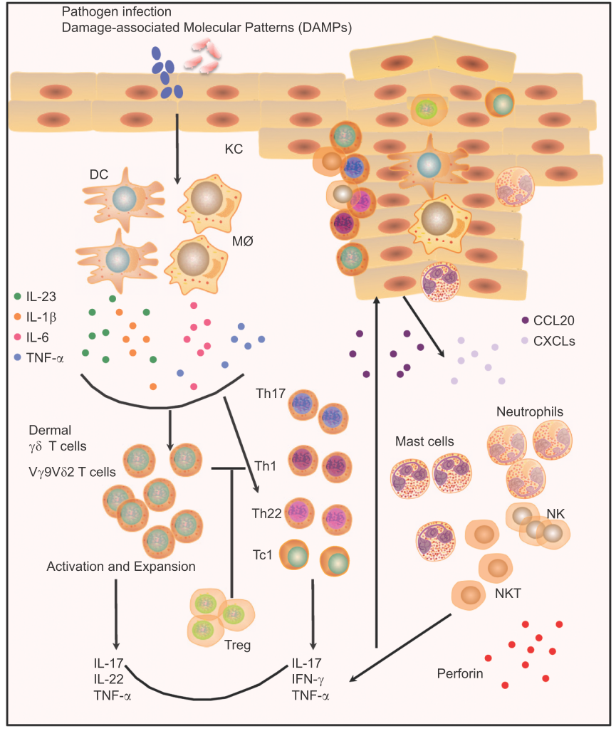
Pathogenesis of psoriasis
Trebuchet MS
Pathogenesis of psoriasis [6]
Notes:
4

Slide 5
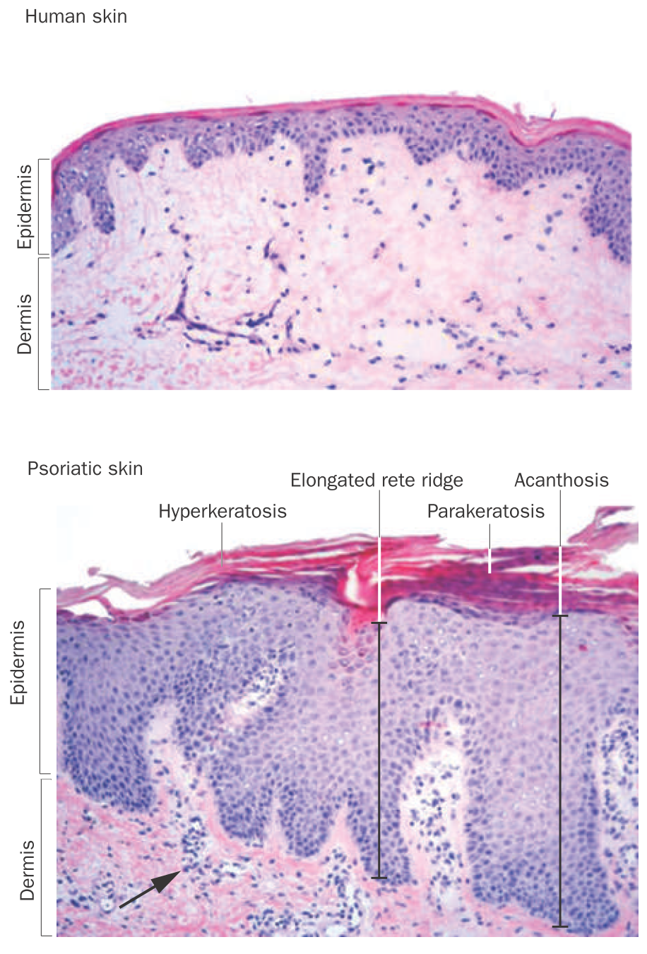
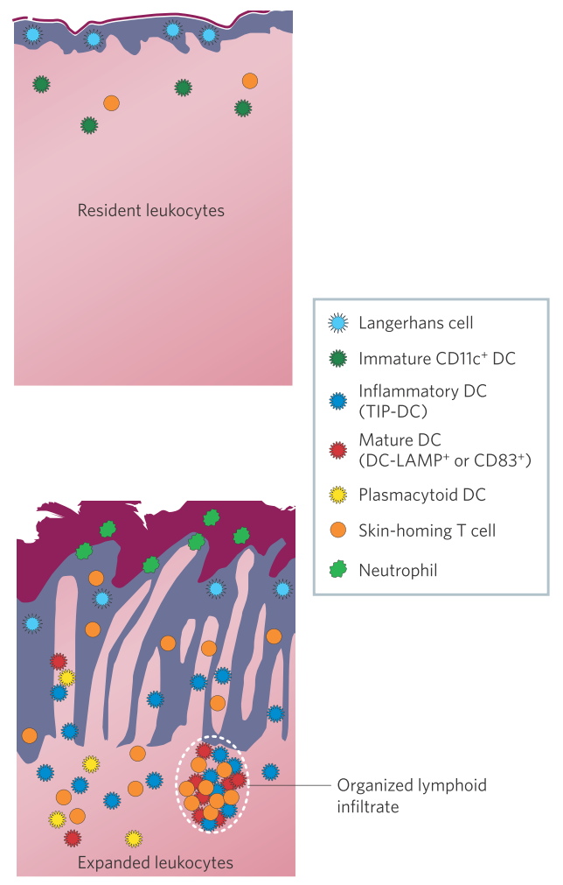
Histological changes in psoriasis
Histological components of a mature psoriatic plaque compared with normal skin [7, 8]
Notes:
5

Slide 6

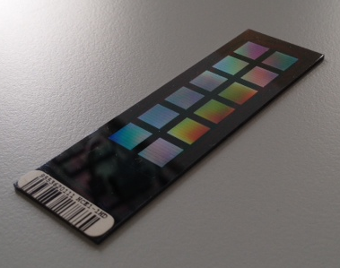
Human Exome BeadChip
Genotyping variants for identify genetic association
Variants from 12k individual exome and WGS
Putative functional exonic variants
Different ethnical groups and different diseases
Exonic content consists of more than 240k markers
12 sample array format
Human Exome BeadChip [9]
Notes:
6

Slide 7
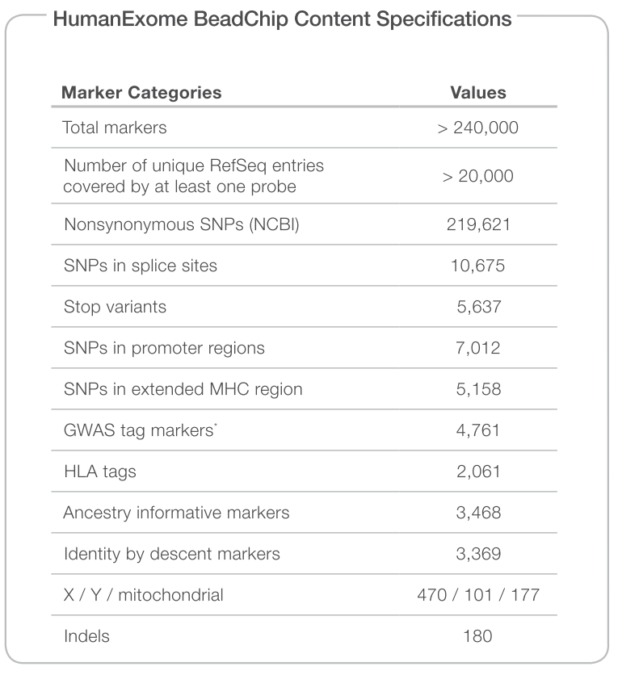
Overview of the Exome Chip
Human Exome BeadChip content [10]
Notes:
7

Slide 8


Psoriasis sample collection
Distribution of cohorts on both chip versions
Total: 12455
Cases/controls: 2533/9922
SNVs: 242102 variants
(Estonian cases/controls: 988/2896)
(German cases/controls: 1545/7026)
ExomeArray 1.0 | ExomeArray 1.1
HCDEMICK | PSEE2
HCDEBONN | PSDE1
HCDEKORA2 | HCEE2
HCPOPGEN
HCGCON
Chip 1.0
Chip 1.1
247870
242102
242901
Overlap of variants
Notes:
8

Slide 9
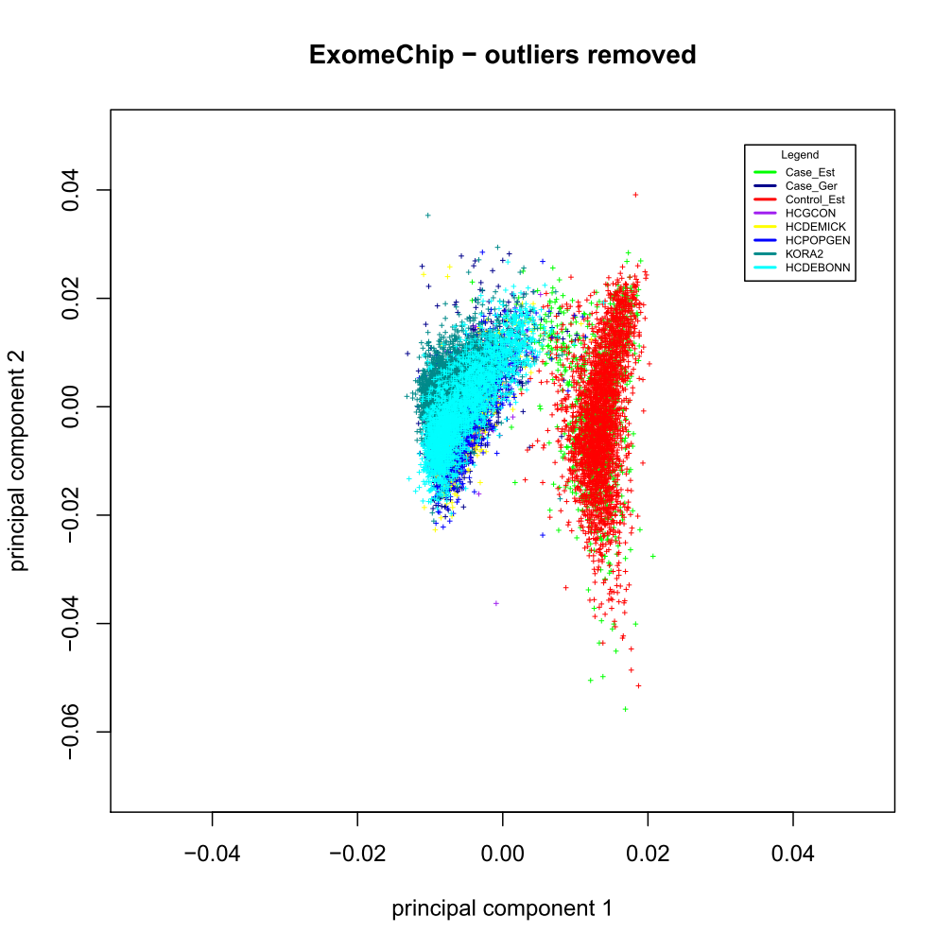
Two different quality controls
 | Without QC | 1st QC | 2nd QC
Individuals (Cases/Control) | 12455 ( 2533/9922) | 11274 (2196/9078) | 11421 (2236/9185)
SNVs | 242102 | 142854 | 142132
German
Estonian
Principal component analysis of 1st QC
Notes:
9

Slide 10
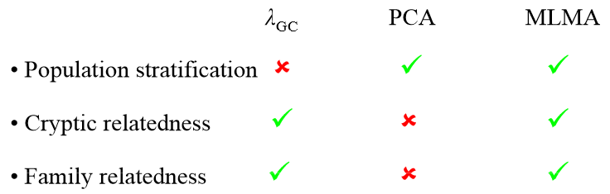
Preliminary results with GCTA
A tool for Genome-wide Complex Trait Analysis
Using the option MLMA
(mixed linear model based association analysis)
Advantages of linear mixed models [11]
Notes:
10

Slide 11
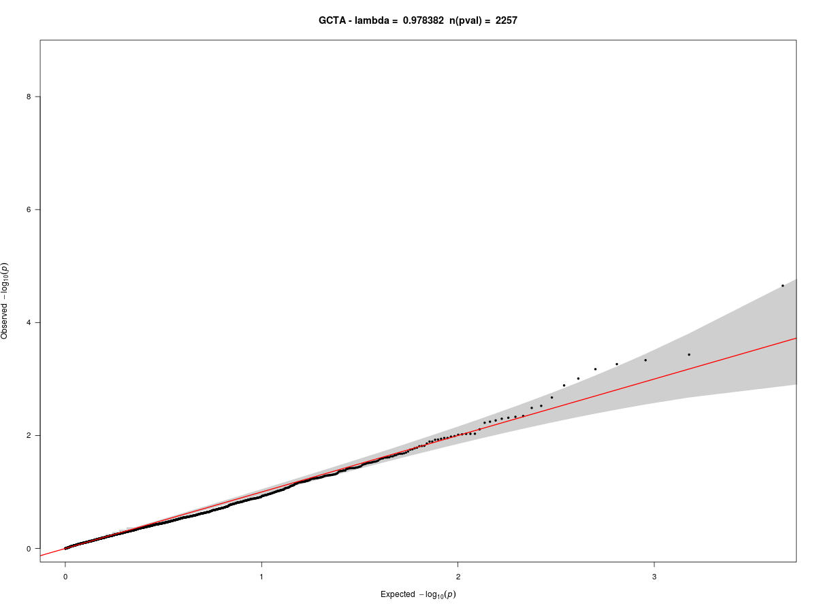
Synonymous SNPs as quality control
QQ plot of synonymous SNPs passed the 1st QC
Notes:
11

Slide 12
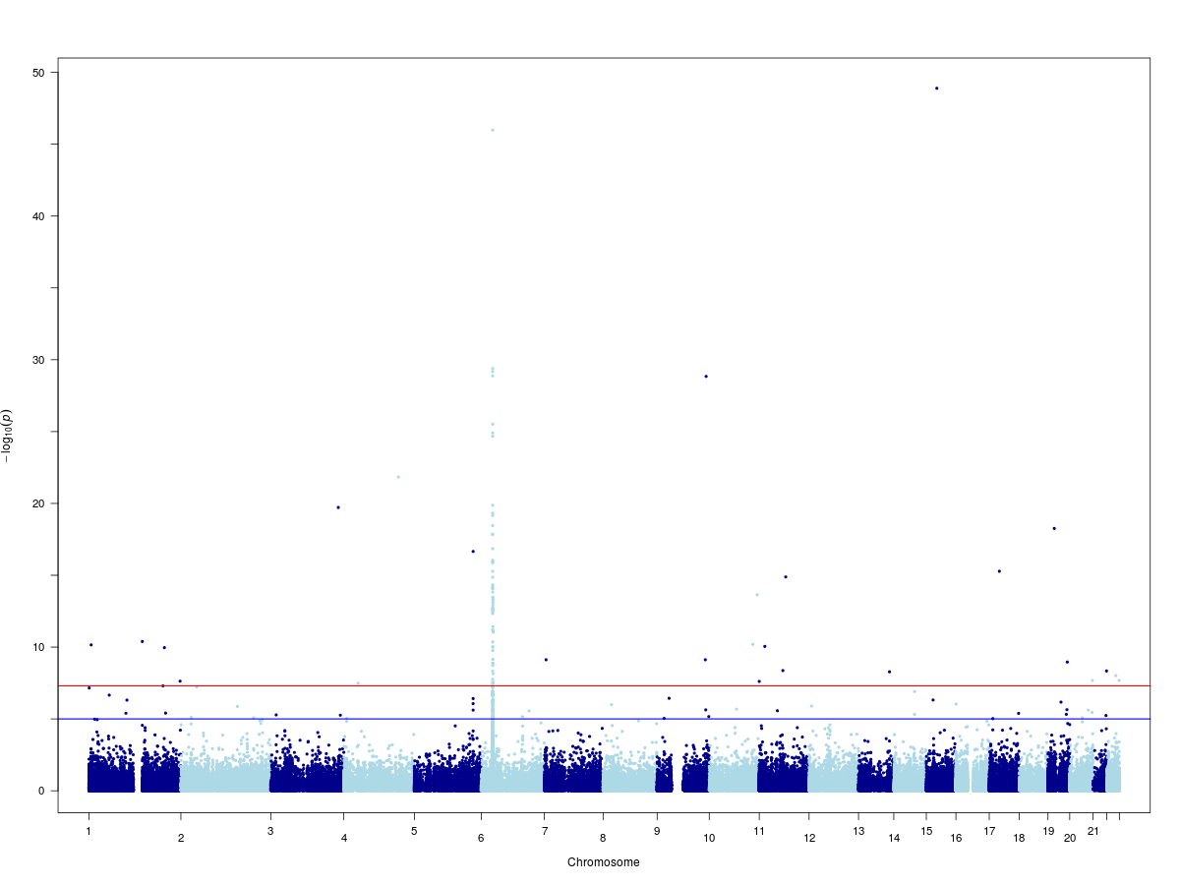
Manhattan plots of variants passed QC
p = 5E-8
QQ plot of all SNPs passed the 1st QC
Notes:
12

Slide 13
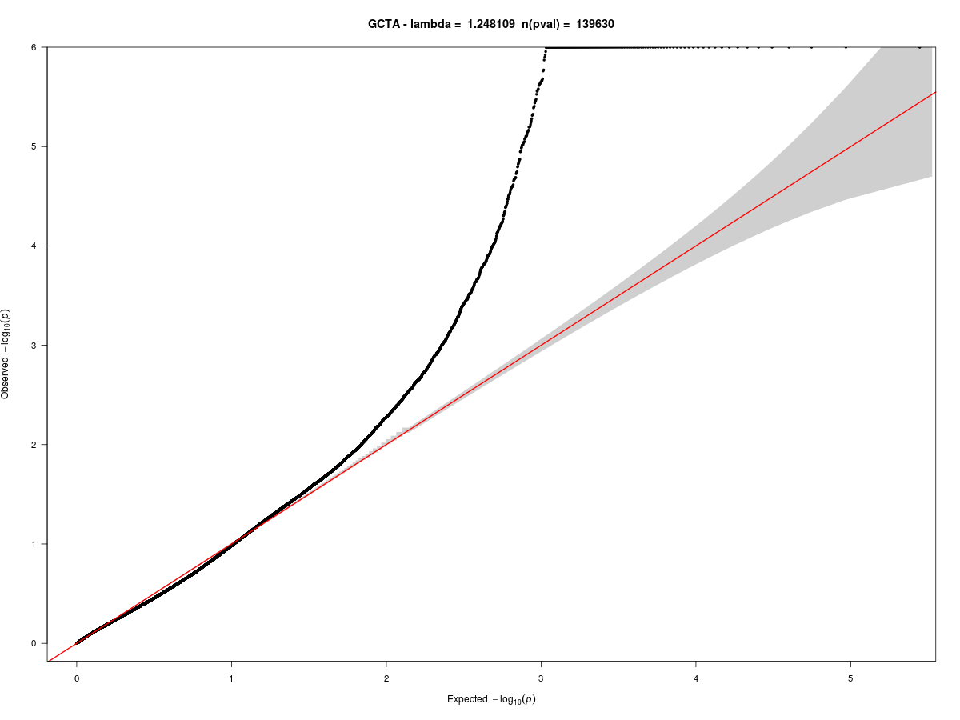
QQ plots of variants passed QC
Notes:
13

Slide 14
Summary of preliminary results
SNP_ID | CHR | POSITION | GENE | P_DAVID | OR_DAVID | 95 % CI_DAVID
rs148783236 | 15 | 50785016 | USP8 | 1,26396E-49 | 1,17 | 1,14-1,19
rs193265694 | 9 | 132632062 | USP20 | 1,44E-29 | 1,45 | 1,36-1,54
rs201837176 | 4 | 147830322 | TTC29 | 1,44678E-22 | 1,18 | 1,14-1,22
rs138480247 | 3 | 182740282 | MCCC1 | 1,90965E-20 | 1,82 | 1,60-2,06
rs201301273 | 19 | 17316832 | MYO9B | 5,47627E-19 | 2,01 | 1,72-2,34
rs12188300 | 5 | 158829527 | upstream of IL12B | 2,19413E-17 | 1,08 | 1,06-1,09
rs142631461 | 17 | 27576202 | CRYBA1 | 5,22167E-16 | 1,23 | 1,17-1,30
rs149184541 | 11 | 71725634 | NUMA1 | 1,30131E-15 | 1,36 | 1,26-1,46
rs41306648 | 10 | 129914025 | MKI67 | 2,25324E-14 | 1,35 | 1,25-1,45
rs7067305 | 24 | 14231292 |  | 1,48205E-12 | 1,20 | 1,14-1,26
rs138083036 | 1 | 144881547 | PDE4DIP | 4,05668E-11 | 1,19 | 1,13-1,25
rs117513116 | 10 | 118100268 | CCDC172 | 6,38899E-11 | 1,87 | 1,55-2,25
rs2232455 | 1 | 6662057 | KLHL21 | 6,96698E-11 | 1,17 | 1,11-1,22
rs61748861 | 11 | 15247307 | INSC | 8,87873E-11 | 1,33 | 1,22-1,46
rs72753850 | 1 | 204589057 | LRRN2 | 1,09237E-10 | 1,64 | 1,41-1,91
rs149880583 | 7 | 4841553 | RADIL | 7,54804E-10 | 1,32 | 1,21-1,45
rs145304925 | 9 | 130444685 | STXBP1 | 7,58439E-10 | 2,12 | 1,67-2,70
rs117633649 | 19 | 52537334 |  | 1,09292E-09 | 1,47 | 1,30-1,67
rs34448455 | 11 | 63994510 | NUDT22 | 4,28762E-09 | 1,49 | 1,31-1,70
rs143719440 | 21 | 47602691 | SPATC1L | 4,56568E-09 | 1,78 | 1,47-2,16
rs144153566 | 13 | 103382660 | CCDC168 | 5,21769E-09 | 1,39 | 1,25-1,55
rs200975071 | 24 | 15029413 | DDX3Y | 6,521E-09 | 1,14 | 1,09-1,20
rs148884710 | 22 | 41546158 | EP300 | 9,60196E-09 | 1,44 | 1,27-1,63
rs34163881 | 22 | 50655543 | SELO | 2,07003E-08 | 1,18 | 1,11-1,25
rs142792529 | 20 | 61470065 | COL9A3 | 2,13623E-08 | 1,18 | 1,12-1,26
rs143303729 | 1 | 247013492 | AHCTF1 | 2,33489E-08 | 1,47 | 1,29-1,69
rs34925440 | 11 | 210660 | RIC8A | 2,42348E-08 | 1,31 | 1,19-1,44
rs35220466 | 4 | 38830355 | TLR6 | 3,21267E-08 | 1,77 | 1,45-2,17
rs41306231 | 1 | 200801935 | CAMSAP2 | 4,99438E-08 | 1,42 | 1,25-1,61
Gen | Chr | SNP | P | OR
CCDC168 | 13 | rs144153566 | 5,22E-09 | 1,39
CCDC172 | 10 | rs117513116 | 6,39E-11 | 1,87
Proteins contain Coiled-Coil Domain
Notes:
14

Slide 15
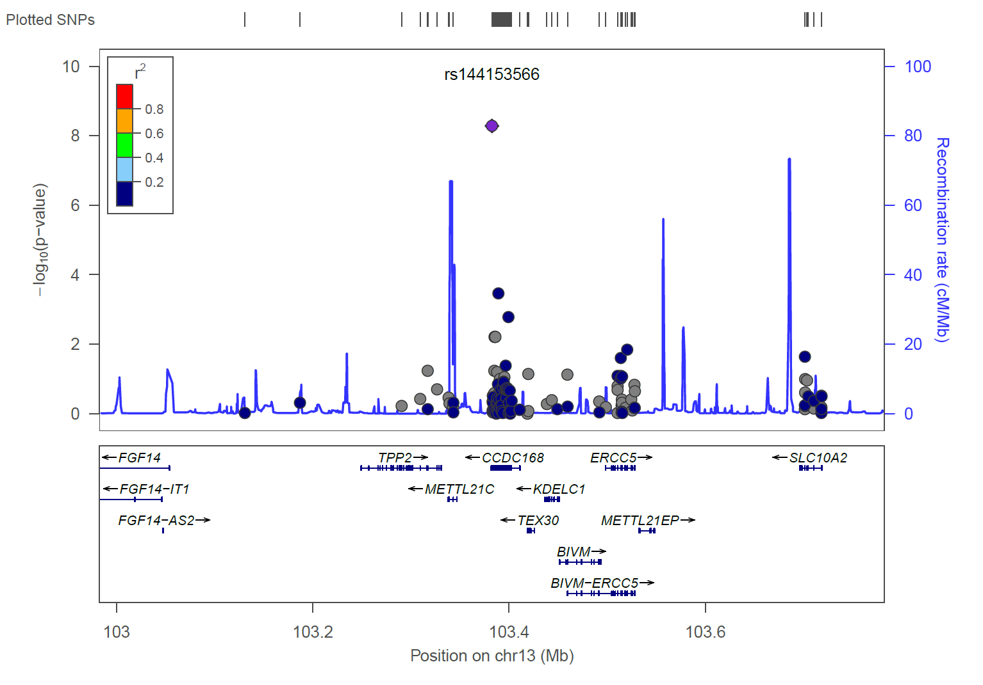
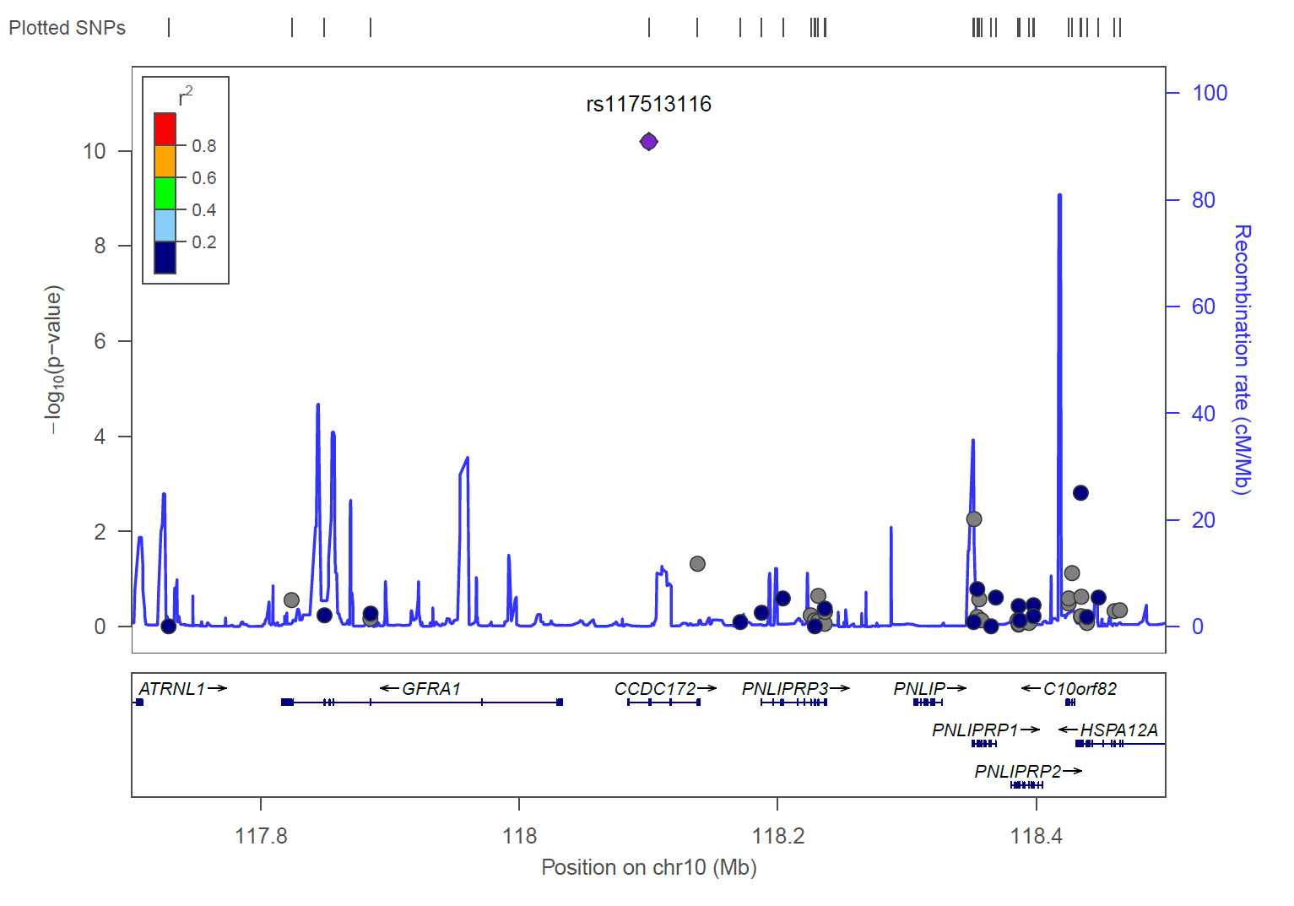

Regional plots
Notes:
15

Slide 16
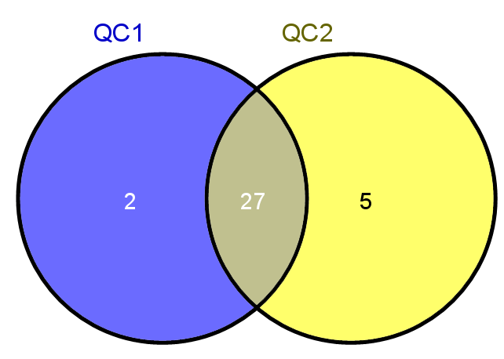
Summary
29 SNPs with p<5e-8 32 SNPs with p<5e-8
Notes:
16

Slide 17
Outlook
Clusterplot analysis
Comparison of both QCs
Include more SNPs in regional plots
Pathway analysis
Metaanalysis
Notes:
17

Slide 18


Acknowledement
Andre Franke
Eva Ellinghaus
David Ellinghaus
Matthias Hübenthal
Frauke Degenhardt
Jörn Bethune
Hansjörg Baurecht
Genotyping:
Tanja Wesse
Sanaz Sedghpour Sabet
DNA-Intake:
Notes:
18

Slide 19
Thank you for your attention

Slide 20


Slide 21
Literature
[1] – http://www.dermis.net/bilder/CD198/550px/img0188.jpg
[2] – http://www.ecopsoriasis.com/2012/12/demografia-de-la-psoriasis.html
[3] – Parisi et al 2013 – Global epidemiology of Psoriasis: A systemic review of incidience and prevalence
[4] – http://www.psoriasisconnect.com/index.jsp
[5] – http://noskindiseases.com/wp-content/uploads/2012/06/Inverse-Psoriasis.jpeg
[6] – Cai et al 2012 - New insights of T cells in the pathogenesis of psoriasis
[7] – Wagner et al 2010 - Psoriasis: what we have learned from mouse models
[8] – Lowes et al 2007 - Pathogenesis and therapy of psoriasis
[9] – http://illumina.com
[10] – Data sheet – Illumina – Human Exome BeadChips
[11] - http://www.hsph.harvard.edu/alkes-price/files/2013/10/ASHG_Price_102313_MLMA.pdf

Slide 22
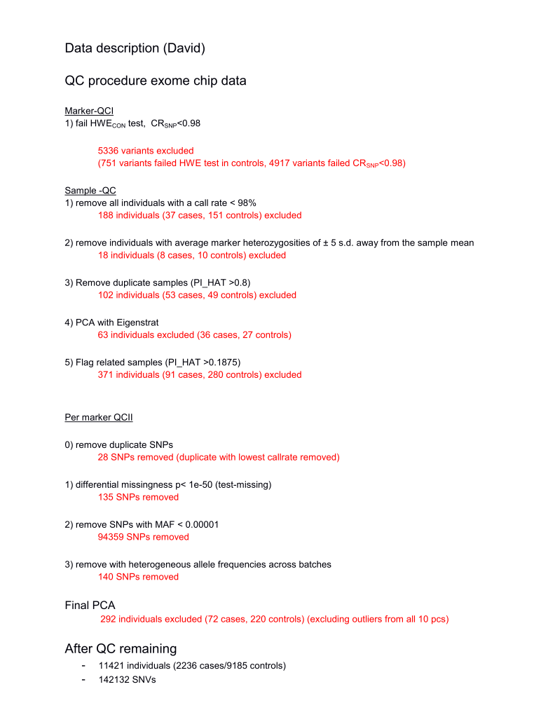
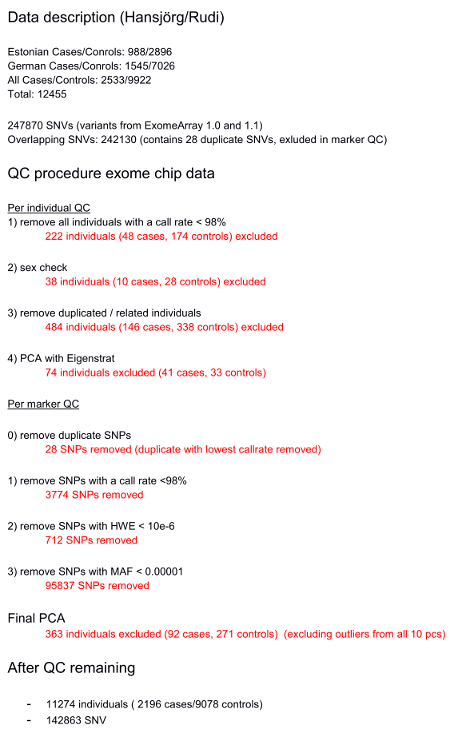
QC1 QC2

Slide 23
Linear mixed models
y = a + bx + g + e
y – phenotype, x – SNP indicator (0,1,2), b – fixed effects ,
g – random effects (relatedness, population), e - residual

